Slide 1
Doing Data Science
Unit 1
Jacquie Cheun
DataScience @ SMU

Slide 2
Grading:
Live Session Assignments (50%)
HW1 is due next week, 1 hour before live session
Case Studies (30%),
Videos and Questions during asynchronous material (BLTs) (15%),
Live Session Attendance (5%).

Slide 3
What is Data Science?
Reproducible vs Replicable
Tools for Data Science

Slide 4
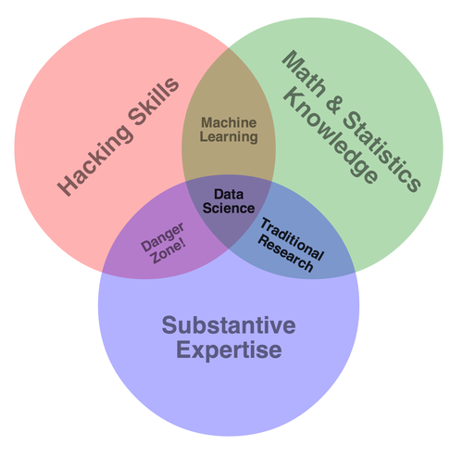
Data Science Venn Diagram https://s3.amazonaws.com/aws.drewconway.com/viz/venn_diagram/data_science.html

Slide 5
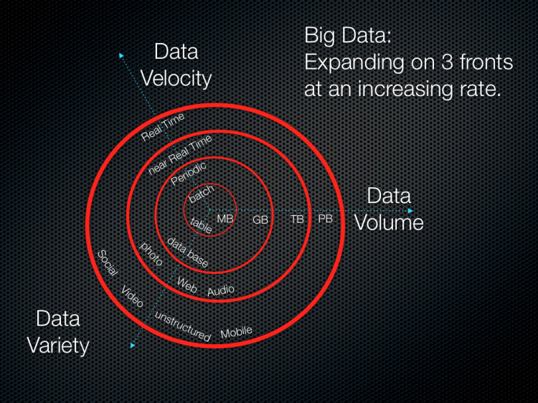
Big Data: the 3 Vs

Slide 6
Data Science profile
Computer Programming
Math
Statistics
Machine Learning
Domain Expertise
Communication, Presentation Skills
Data Visualization

Slide 7
Reproducible research
Use specific set of computational functions/analyses (usually specified in terms of code) and original data to recreate findings
Replicable: recreate findings with new data
A study is only replicable if you perform the exact same experiment (at least) twice, collect data in the same way both times, perform the same data analysis, and arrive at the same conclusions.
http://languagelog.ldc.upenn.edu/nll/?p=21956

Slide 8
Why is replicability important?
Open Source
Public research
Business/Private Sector

Slide 9
Tools for reproducible research
R
Knitr
RMarkdown
RStudio
Section 1.5.1, install R and RStudio, and all packages on page xix

Slide 10
Workflow of Reproducible research
Data Gathering
Data Analysis
Results Presentation

Slide 11
Practical tips
Document everything
Ensure compatibility of your software/libraries/packages (troubleshooting assistance)
Comment your code (variable/argument names should not be cryptic)
Source code comment header

Slide 12
R data structures https://jamesmccaffrey.wordpress.com/2016/05/02/r-language-vectors-vs-arrays-vs-lists-vs-matrices-vs-data-frames
Vector: collection of items of fixed size (all of same type)
List: can hold items of different types and list size can be increased on the fly
Matrix: 2-D vector (fixed size, fixed type)
Array: a vector with one or more dimensions
Data frame: each column has items of same types and columns can have headers

Slide 13
Getting started with R
#Print R session info -- why is this useful?
sessionInfo()
# c(combine) function : create vectors
NumVec ← c (2, 3, 4)
CharVec ← c (“doing”, “data”, “science”)

Slide 14
# cbind()/rbind() : combine vectors side-by-side
StringNumObj ← cbind(NumVec, CharVec)
# data.frame() : create an object with rows and columns
StringNumObj ← data.frame(NumVec, CharVec)
# Reassign row.names
row.names(StringNumObject) ← c("First", "Second", "Third")
Why use data.frame when we have cbind()/rbind()?

Slide 15
# $ : component selection
NewNumeric ← StringNumObj$NumVec
# head()/tail() : select first/last few rows
head(cars)
# [rows,columns] subscript operators, : sequence operator
cars[3:7, ]

Slide 16
# str(..)
compactly display the structure of an R object
E.g,
3 obs. of 2 variables:
$ NumVec : num 2 3 4
$ CharVec: Factor w/ 3 levels "data","doing",..: 2 1 3
# summary(..)
display summary statistics for analysis (mean, quantiles, etc)
E.g.,
NumVec CharVec
Min. :2.0 data :1
1st Qu.:2.5 doing :1
# dim(..)
retrieve or set the dimensions of an object (array, matrix, dataframe)
E.g.,
[1] 3 2

Slide 17
Missing/extreme values:
NA = not available
NaN = undefined
Inf = extremely small/large (infinity)

Slide 18
What did you learn today?
Questions?

